Slide 1

Walsingham Sailing
Team Meeting – 27August
  Coach – John Wandling (wandling42@gmail.com)
  Home – 757 238 3267
  Cell – 757 615 7979
  www.jwandling.net
  Serious about sailing, serious about having fun
  Please fill out contact sheet

Slide 2
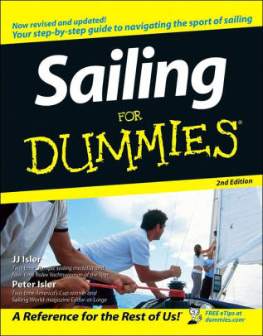
The basic text –
Peter and JJ Isler

Slide 3
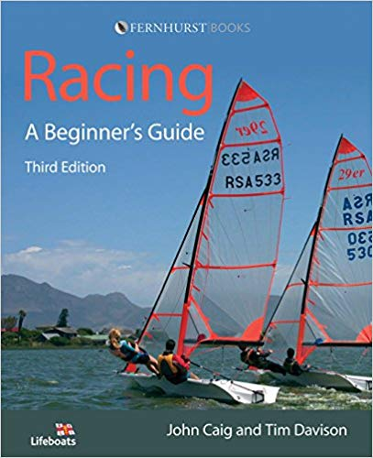
The Beginner Text

Slide 4

Everyone reads this

Slide 5
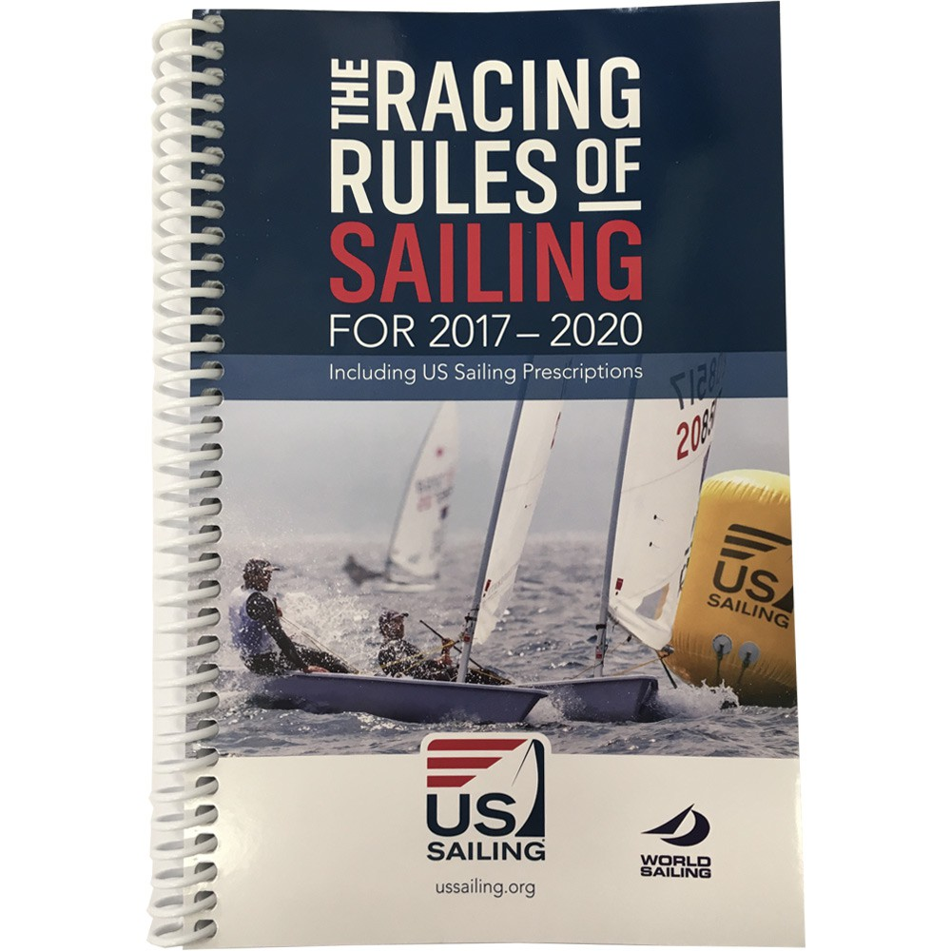
The Rules

Slide 6
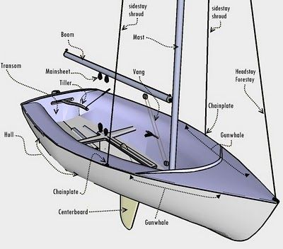
FJ – Flying Junior

Slide 7

Governs sailboat racing in US
World Sailing (former ISAF) www.ussailing.org

Slide 8
Our Focus This Fall
Boat Handling – Tack, Jibe, Points of sail
Race Management – Starting, Strategy and Tactics
Team Racing

Slide 9
Walsingham Academy Sailing
A typical practice Day:
3:30 pm - Sailors Arrive at HYC and get ready.
4:00 pm - Chalk talk *Sailors expected to be dressed
4:15pm - Sailors rig boats, sail to practice area
4:30 - 6:00 pm - Practice on Water
6:00 pm - Sailors on shore - downrig boats
6:15 pm - Practice de-brief,
6:30 pm - Sailors depart/get picked up
NOTE: If you are picked up by other than a parent, please have a note from a parent or guardian indicating the name of the person picking you up and the date.

Slide 10
Sailing Packing List:
Lifejacket
Helmet
Swimsuit
Water Shoes
Water Bottle
Sunglasses
Rash-shirt
Sunscreen
Whistle
Bailer
Sailing Gloves
18” ribbon or yarn
Note:
(1) REI lists a whitewater helmet for under $30.00 that would be suitable.
(2) They have a nice compact life jacket for about $100.00. Please pick a bright color.
(3) Get “croakies” for your sunglasses or some type that stay with you.
(4) Attach your whistle to your life jacket with a lanyard.
(5) You can make a suitable bailer by cutting the top off of a plastic bleach or detergent bottle, keep the handle intact so you can “scoop” water out of your boat.

Slide 11
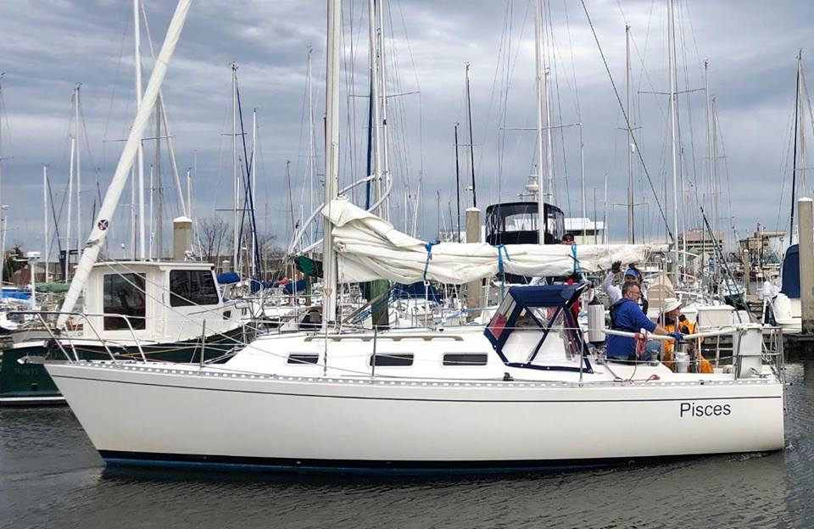
S/V Pisces

Slide 12
FJ Roll Tack
https://www.youtube.com/watch?v=hBivxKxbB3A

